Slide 1

Université de Mostaganem — Dr. Madani BELACEL
TIC COURSE 02
Computer Science and Hardware: Architecture and Operation
Dr. BELACEL Madani
Année universitaire 2026-2027 / Academic Year 2026-2027
Université de Mostaganem - Département Mathématiques et Informatique

Slide 2
Université de Mostaganem — Dr. Madani BELACEL
Course Outline
▪ 1. Computing: Definition
▪ 2. Generations of Computers
▪ 3. Von Neumann Architecture
▪ 4. Hardware: The System Unit
▪ 5. Peripherals
▪ 6. Software: System and Application
▪ 7. Getting Started with a Computer

Slide 3
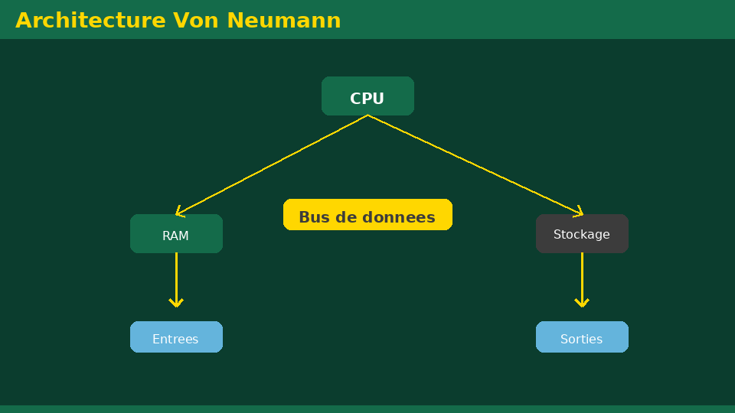
Université de Mostaganem — Dr. Madani BELACEL
Section 1
Computing: Definition

Slide 4
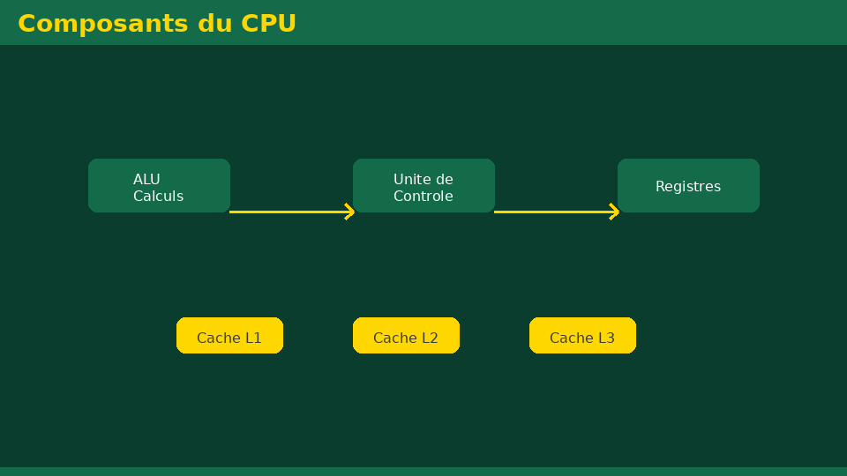
Université de Mostaganem — Dr. Madani BELACEL
1 - Computing: Definition
▪ Computer science = INFORMATION + AUTOMATIC.
▪ The science of automatic and rational processing of information.
▪ Fields: programming, networks, databases, AI.
▪ Based on algorithms: finite sequences of precise instructions.

Slide 5
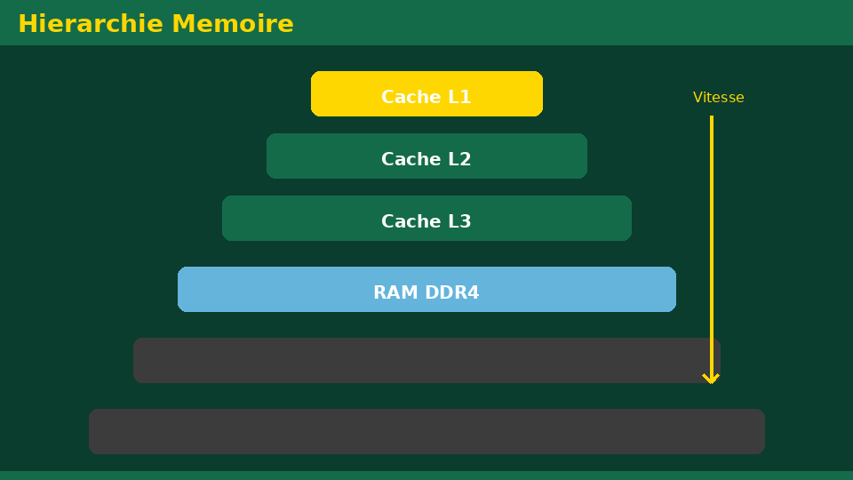
Université de Mostaganem — Dr. Madani BELACEL
Section 2
Generations of Computers

Slide 6
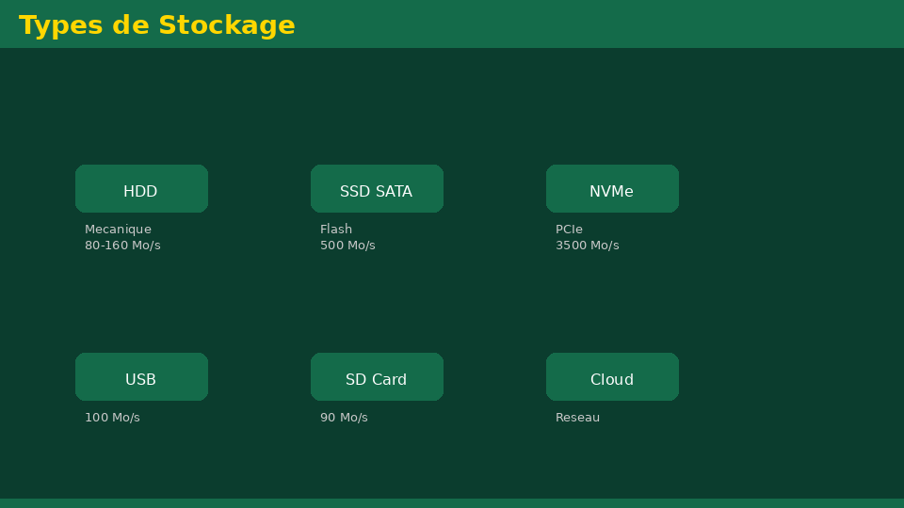
Université de Mostaganem — Dr. Madani BELACEL
2 - Generations of Computers
▪ 1st generation (1945-1955): vacuum tubes, very bulky.
▪ 2nd generation (1955-1965): transistors.
▪ 3rd generation (1965-1975): integrated circuits.
▪ 4th generation (1975-...): microprocessors, PCs.
▪ 5th generation: artificial intelligence and parallelism.

Slide 7
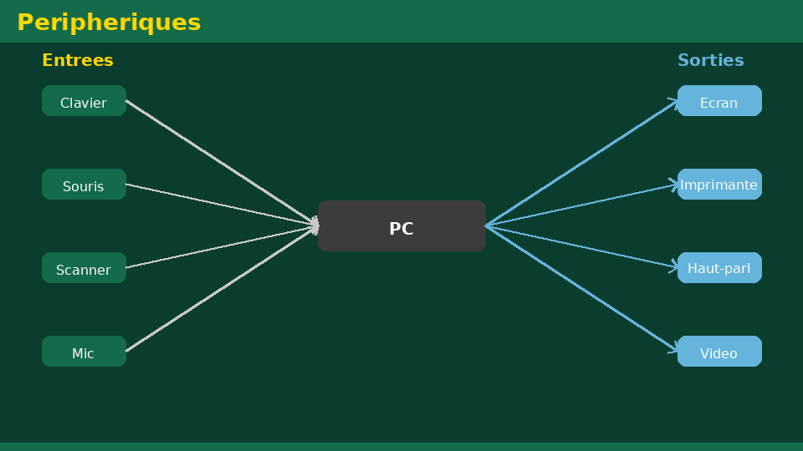
Université de Mostaganem — Dr. Madani BELACEL
Section 3
Von Neumann Architecture

Slide 8
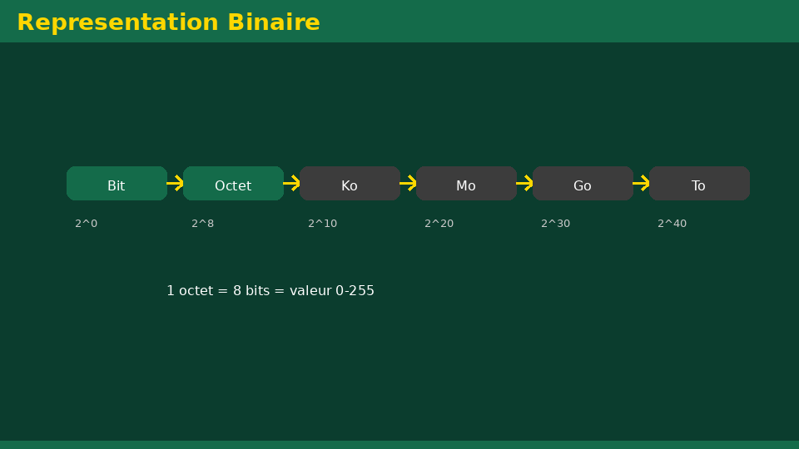
Université de Mostaganem — Dr. Madani BELACEL
3 - Von Neumann Architecture
▪ Central Processing Unit (CPU): executes instructions.
▪ Main memory: stores programs and data.
▪ Input/output units: communication with the outside.
▪ Buses: transfer channels between components.
▪ Stored-program model: both data and instructions in memory.

Slide 9
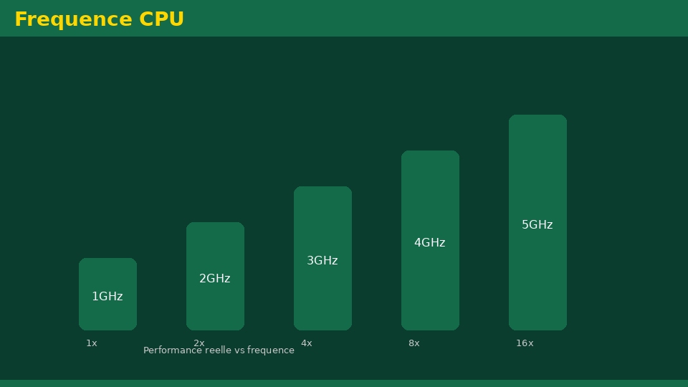
Université de Mostaganem — Dr. Madani BELACEL
Section 4
Hardware: The System Unit

Slide 10
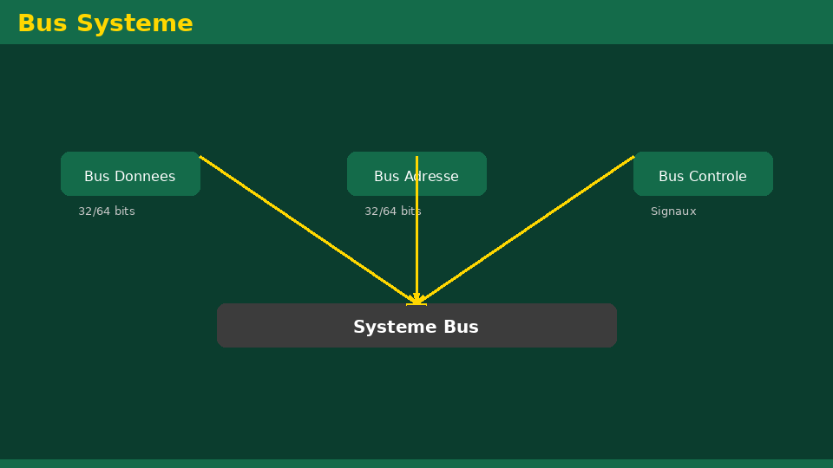
Université de Mostaganem — Dr. Madani BELACEL
4 - Hardware: The System Unit
▪ Motherboard: hosts and connects all components.
▪ Processor (CPU): frequency in GHz, multiple cores.
▪ RAM: volatile fast working memory.
▪ Hard disk / SSD: permanent data storage.
▪ Power supply, fans and case.

Slide 11
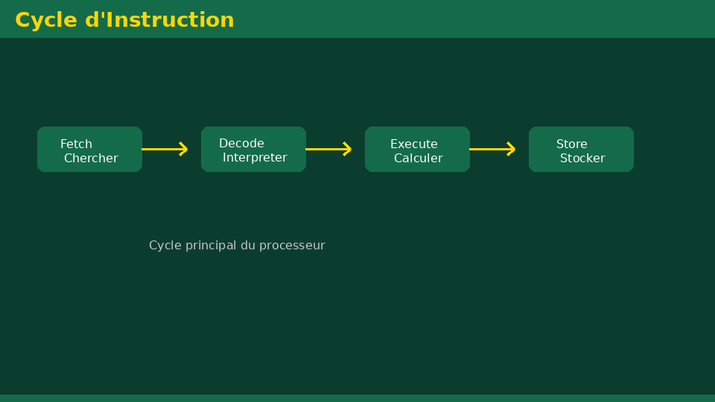
Université de Mostaganem — Dr. Madani BELACEL
Section 5
Peripherals

Slide 12
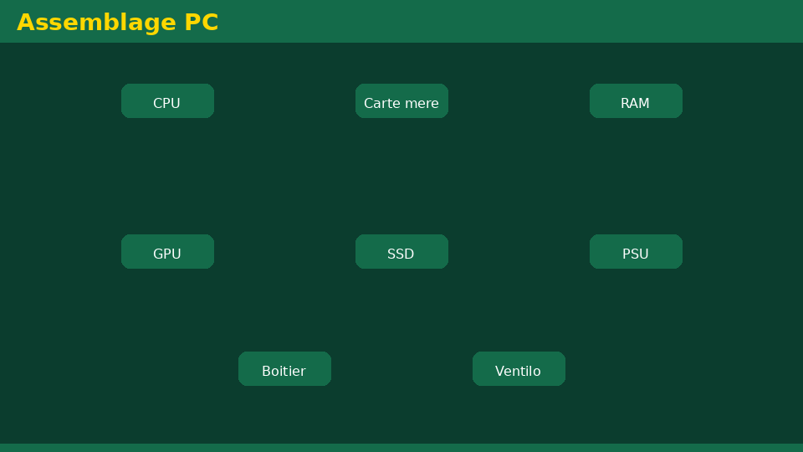
Université de Mostaganem — Dr. Madani BELACEL
5 - Peripherals
▪ Input: keyboard, mouse, scanner, microphone, camera.
▪ Output: monitor, printer, speakers, projector.
▪ Input/Output: touch screens, external drives, modems.
▪ Selection criteria: resolution, speed, connectors (USB, HDMI).

Slide 13
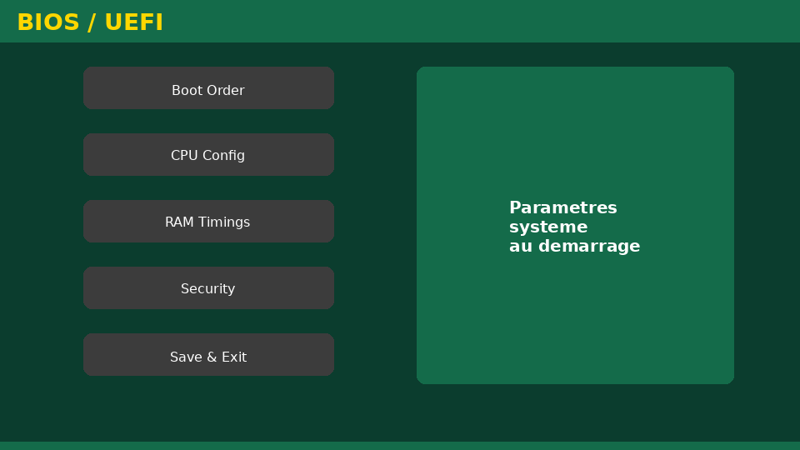
Université de Mostaganem — Dr. Madani BELACEL
Section 6
Software: System and Application

Slide 14
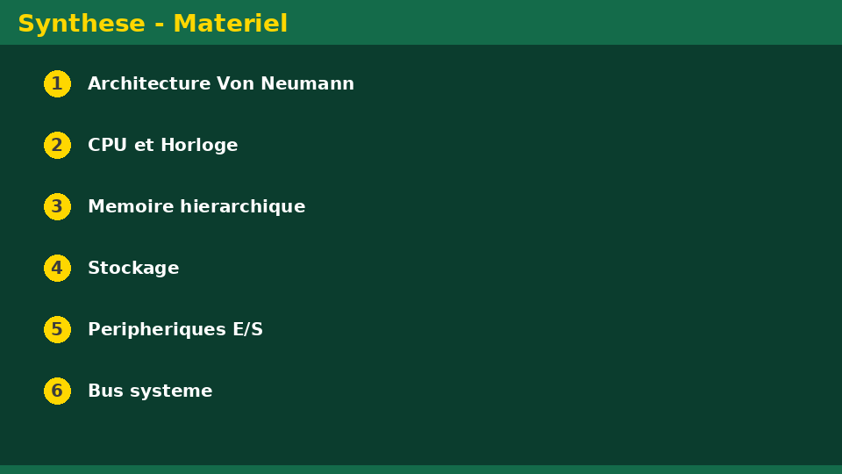
Université de Mostaganem — Dr. Madani BELACEL
6 - Software: System and Application
▪ System software: the operating system (Windows, Linux, macOS).
▪ Role of the OS: manages resources, files and devices.
▪ Application software: Word, Excel, browsers, games.
▪ Programming languages: Python, C, Java.
▪ Compiler and interpreter: translating source code.

Slide 15
Université de Mostaganem — Dr. Madani BELACEL
Section 7
Getting Started with a Computer

Slide 16
Université de Mostaganem — Dr. Madani BELACEL
7 - Getting Started with a Computer
▪ Power-on and boot sequence.
▪ User session: login and password.
▪ Desktop: icons, taskbar, start menu.
▪ Correct shutdown: avoid data loss.
▪ Basic maintenance: cleaning, updates, antivirus.

Slide 17
Université de Mostaganem — Dr. Madani BELACEL
Practical Interest
▪ Choose a PC rationally according to needs (study, office, gaming).
▪ Diagnose a simple problem: insufficient RAM, full disk.
▪ Read and compare computer technical specifications.
▪ Install and use the software needed for studies.

Slide 18
Université de Mostaganem — Dr. Madani BELACEL
Self-Assessment (MCQ)
1. What does CPU stand for?
a) Central Process Unit
b) Central Processing Unit
c) Both answers
2. Which memory is volatile?
a) Hard disk
b) RAM
c) SSD
3. Windows is a(n):
a) Application software
b) Operating system
c) Programming language

Slide 19
Université de Mostaganem — Dr. Madani BELACEL
Conclusion
▪ The computer follows the von Neumann architecture: CPU, memory, I/O.
▪ Hardware and software are inseparable in information processing.
▪ Knowing the components helps use and maintain your machine.
▪ Next course: the Windows operating system.

Slide 20
Université de Mostaganem — Dr. Madani BELACEL
References
- A. Tanenbaum, "Structured Computer Organization", Pearson.
- J. Fayn and P. Legars, "Micro-computing", Dunod.
- ICT Course materials, University of Mostaganem.
- www.ccmbench.com - hardware basics.

Slide 21
Université de Mostaganem — Dr. Madani BELACEL
Thank you for your attention!
Questions?
Dr. BELACEL Madani

